Slide 1
Student Expenditure Calculator
By Hüseyin Öztürk
Matriculation Number: 102106845
09/09/2022
IU Internationale Hochschule

Slide 2
GitHub Repository
https://github.com/HuseyinOzturk2003/Web-Development.git

Slide 3
Purpose Of The Web Application
Most students have limited budget yet have so many expenses, by calculating how much we spend on certain things we can make changes to the way we spend our money. The student expenditure calculator allows users to input their monthly spending on boxes filled with different topics such as: rent, food, entertainment, transportation etc. After all input is given, the application calculates how much money the amount of spending corresponds in yearly and 3 yearly periods. At the end, users will hopefully make small but significant changes to their lives. Apart from students, anyone else can utilize this application for both entertainment and educational purposes.

Slide 4
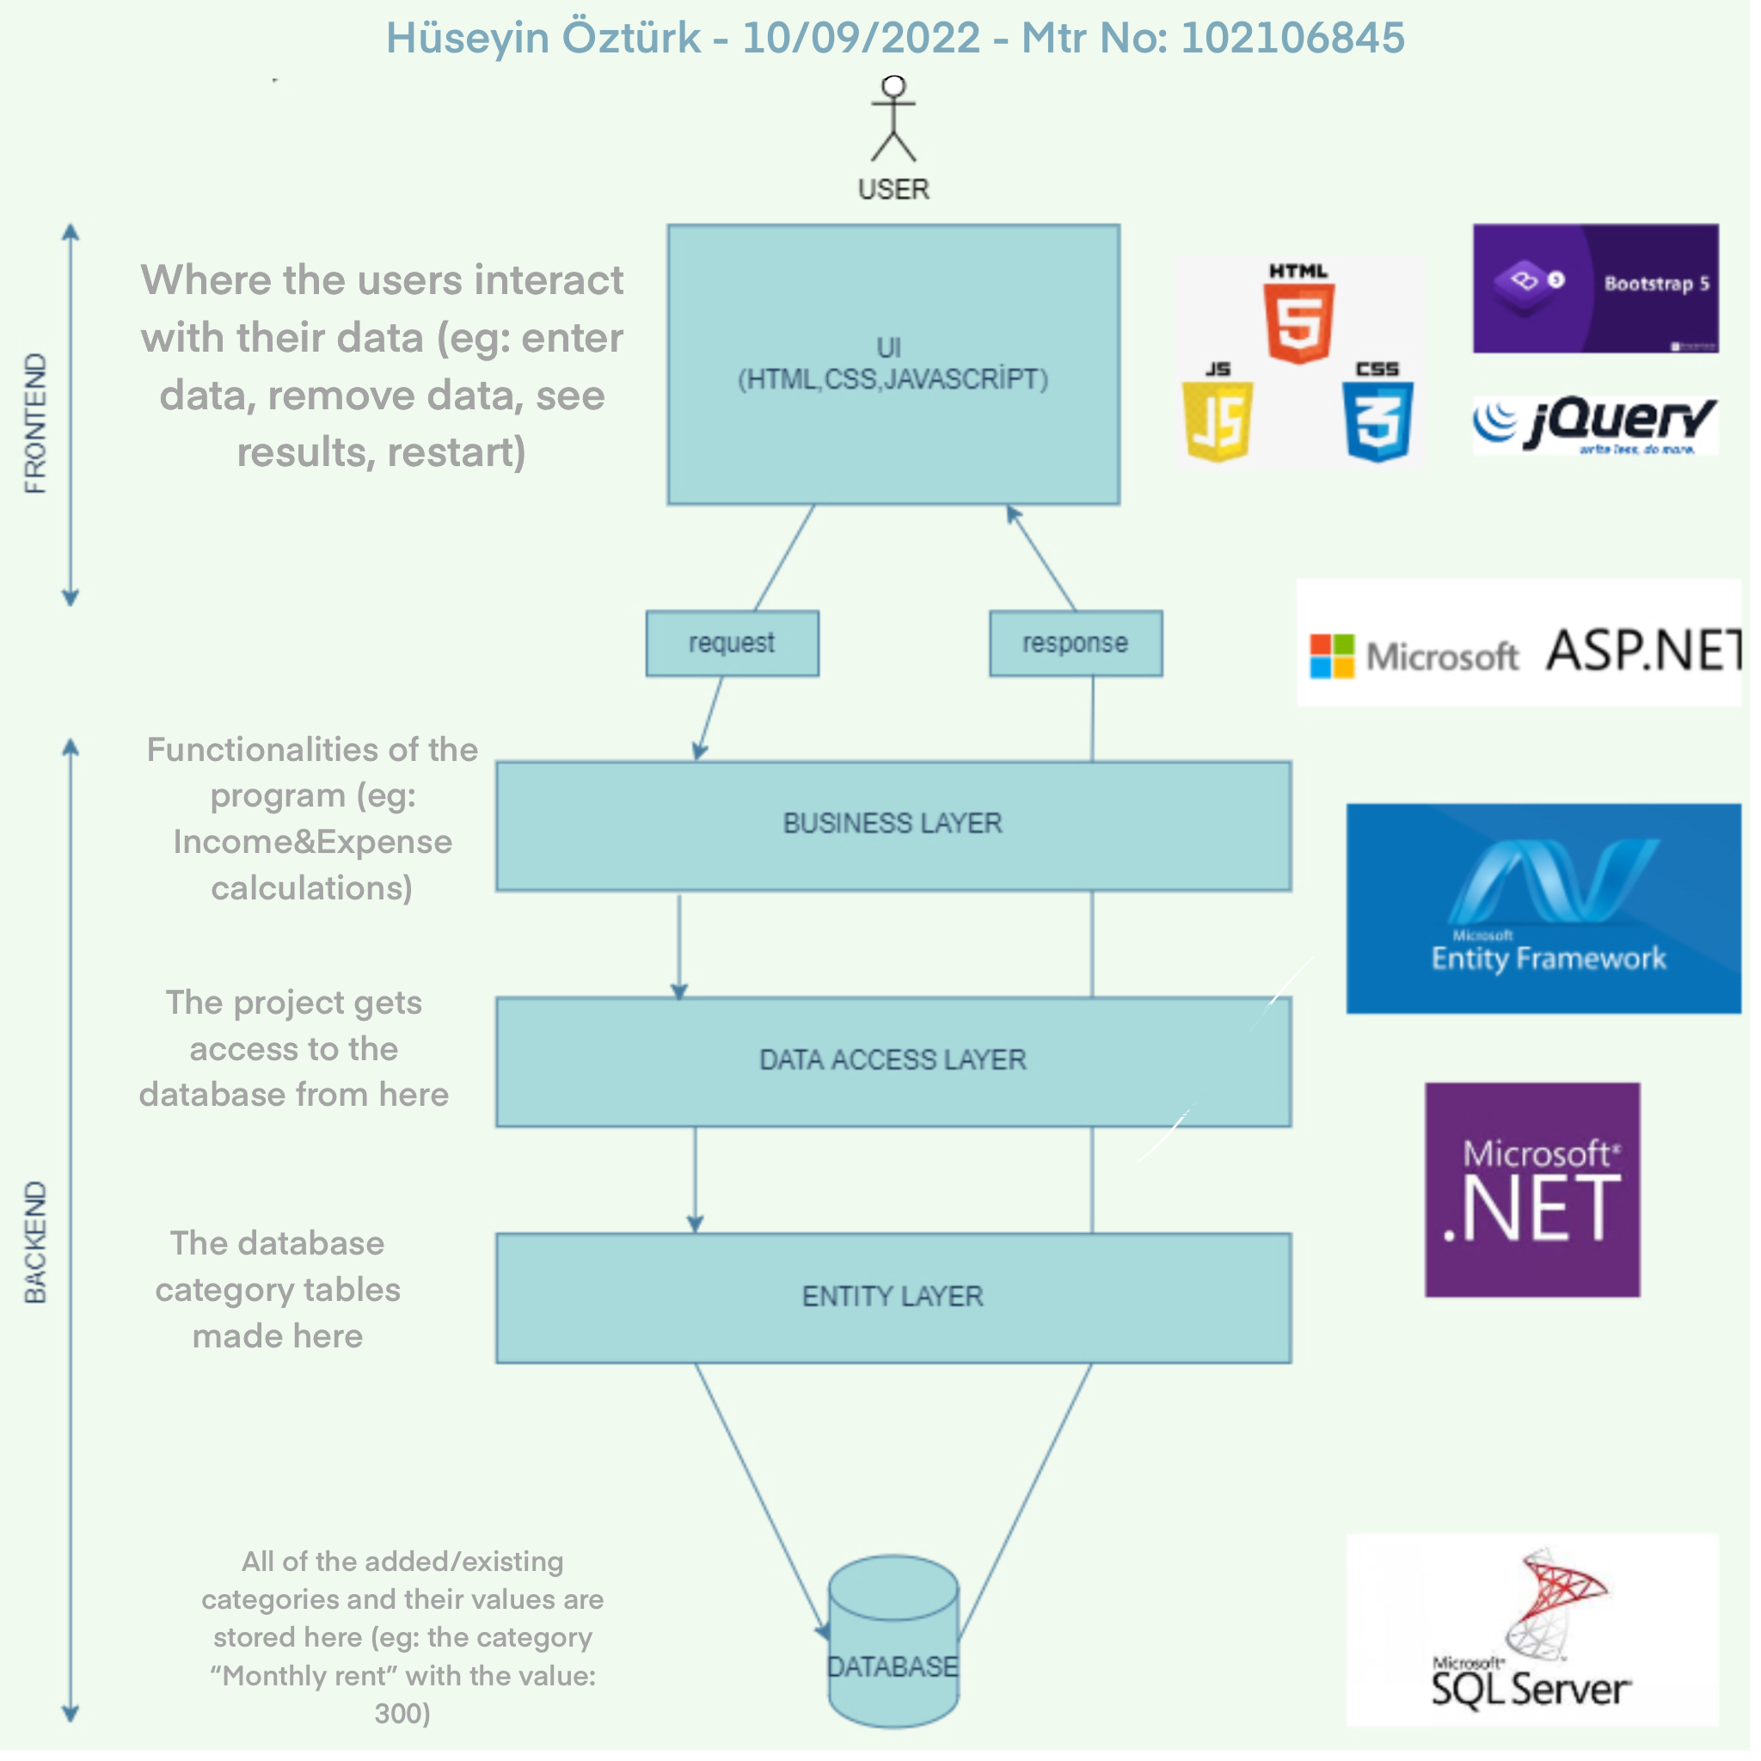
Architecture Diagram

Slide 5
Front End
I have chosen HTML, CSS and Javascript as my front end technologies. They are the fundamental technologies for front-end development. I also used Bootstrap and Jquery frameworks to assign more functionalities to my website with less code.
Back End
I have chosen Asp.net written in C# as my back end technology, as I had previous experience with it. I have chosen these technologies because I personally found it easier to learn. Finally as my database I have chosen Microsoft SQL database server to go along with other microsoft technologies. (DE: Visual Studio 2022)

Slide 6
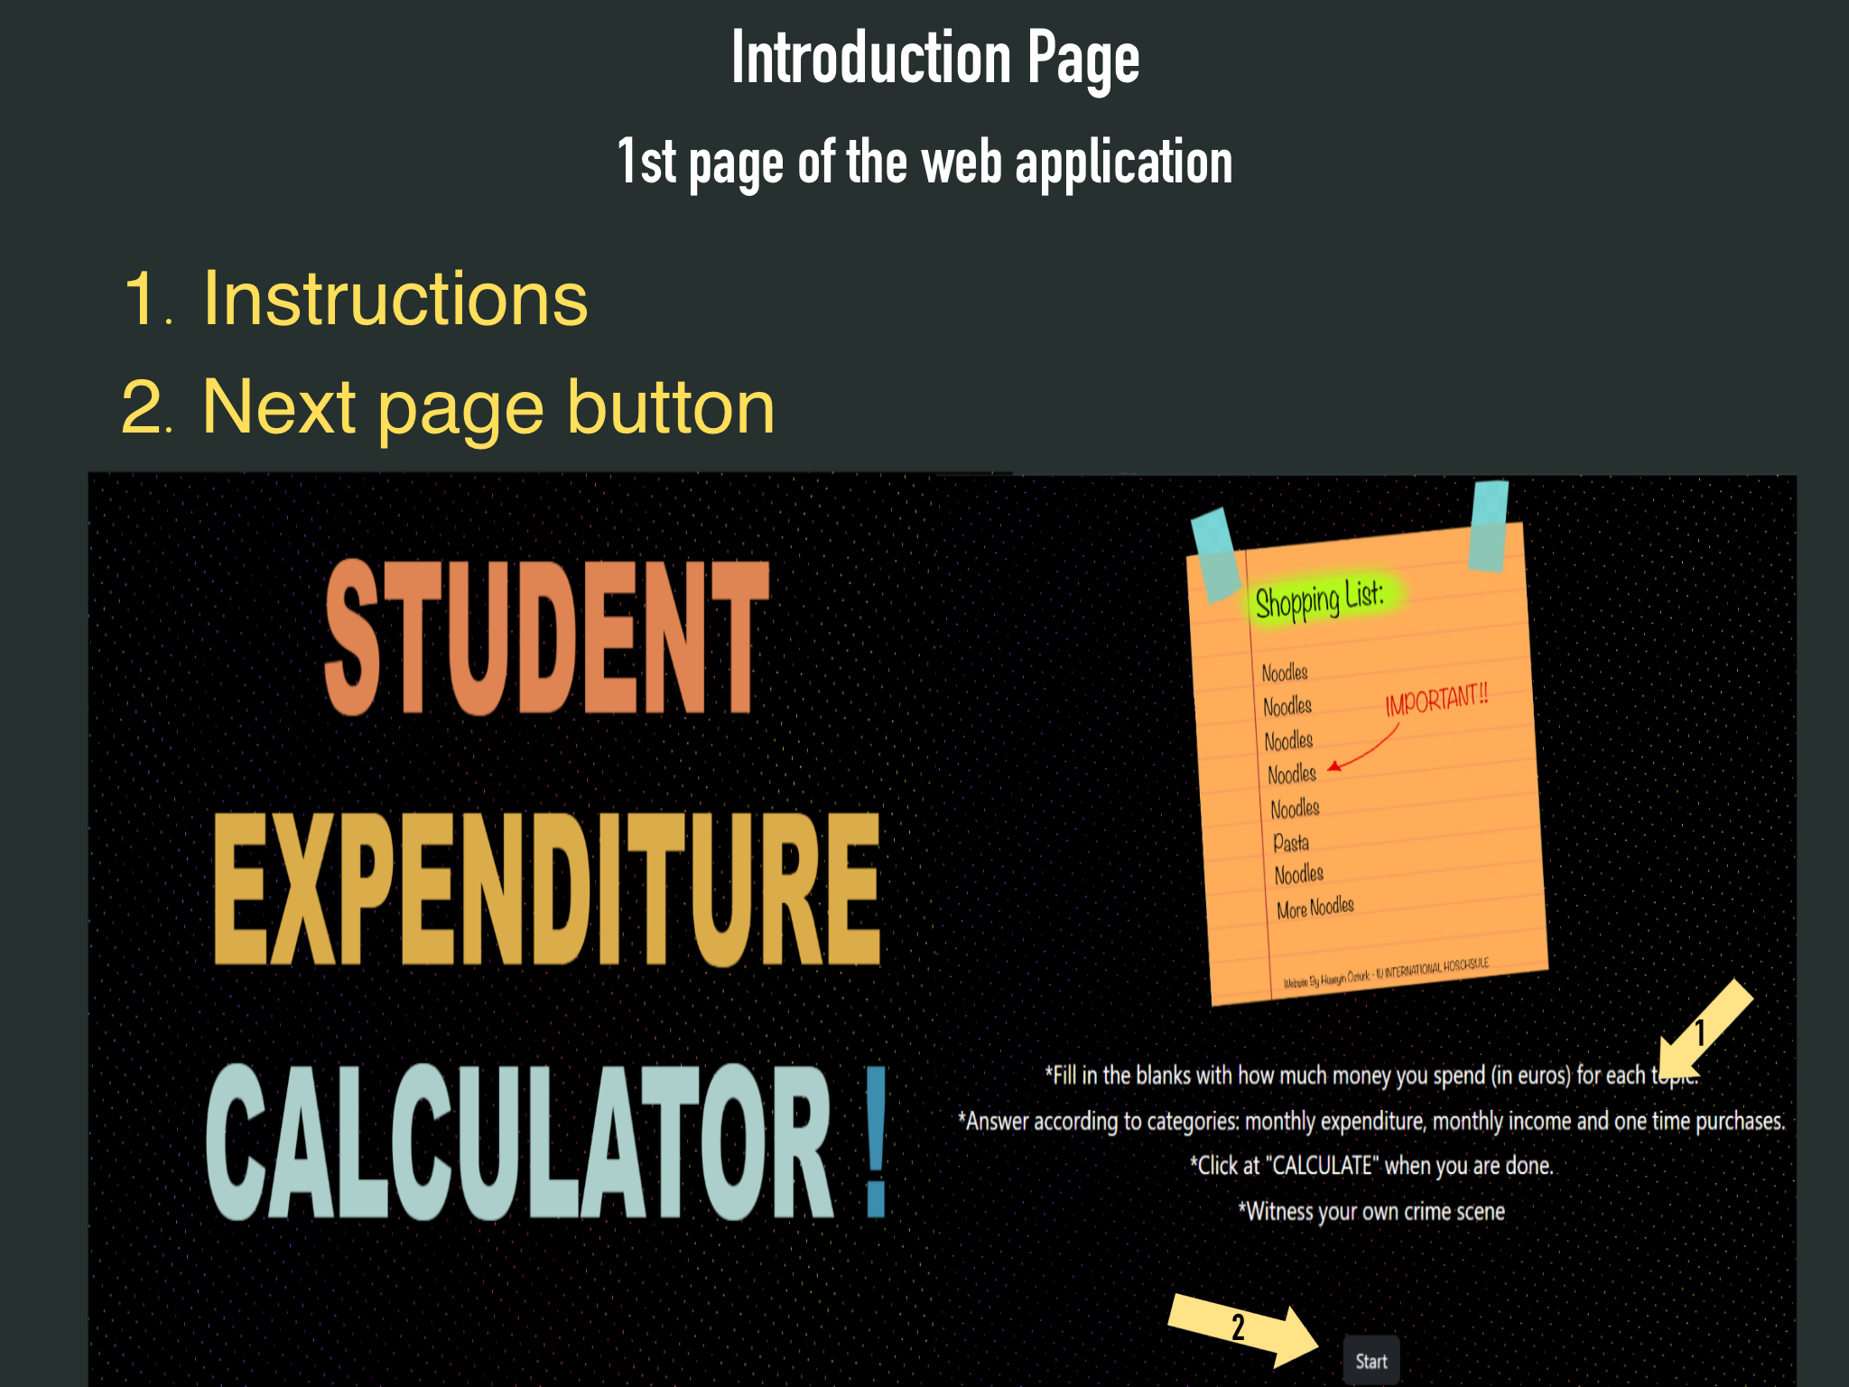

Slide 7
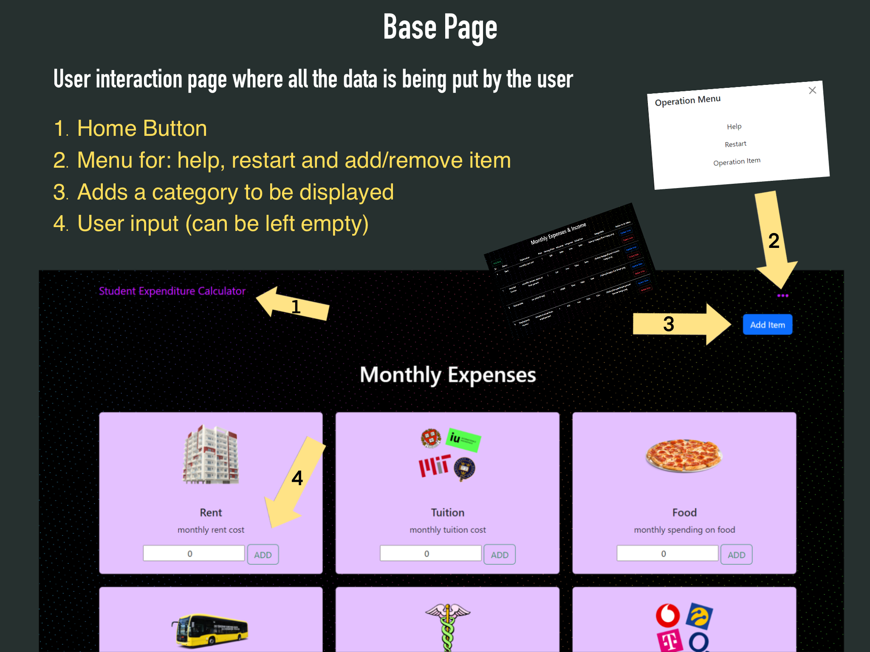

Slide 8
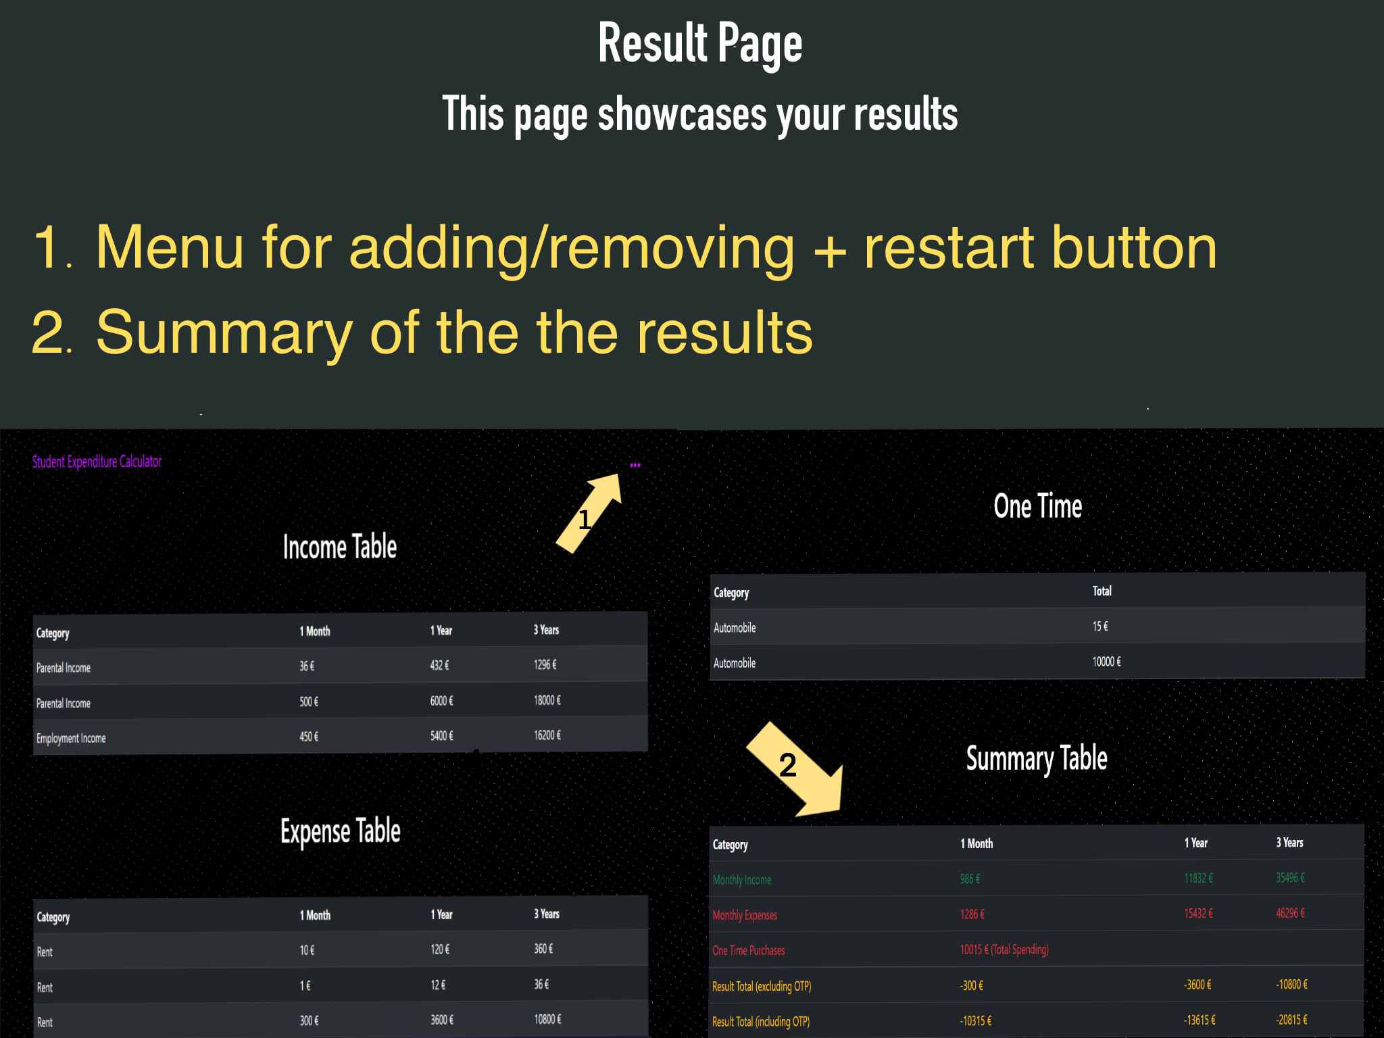

Slide 9
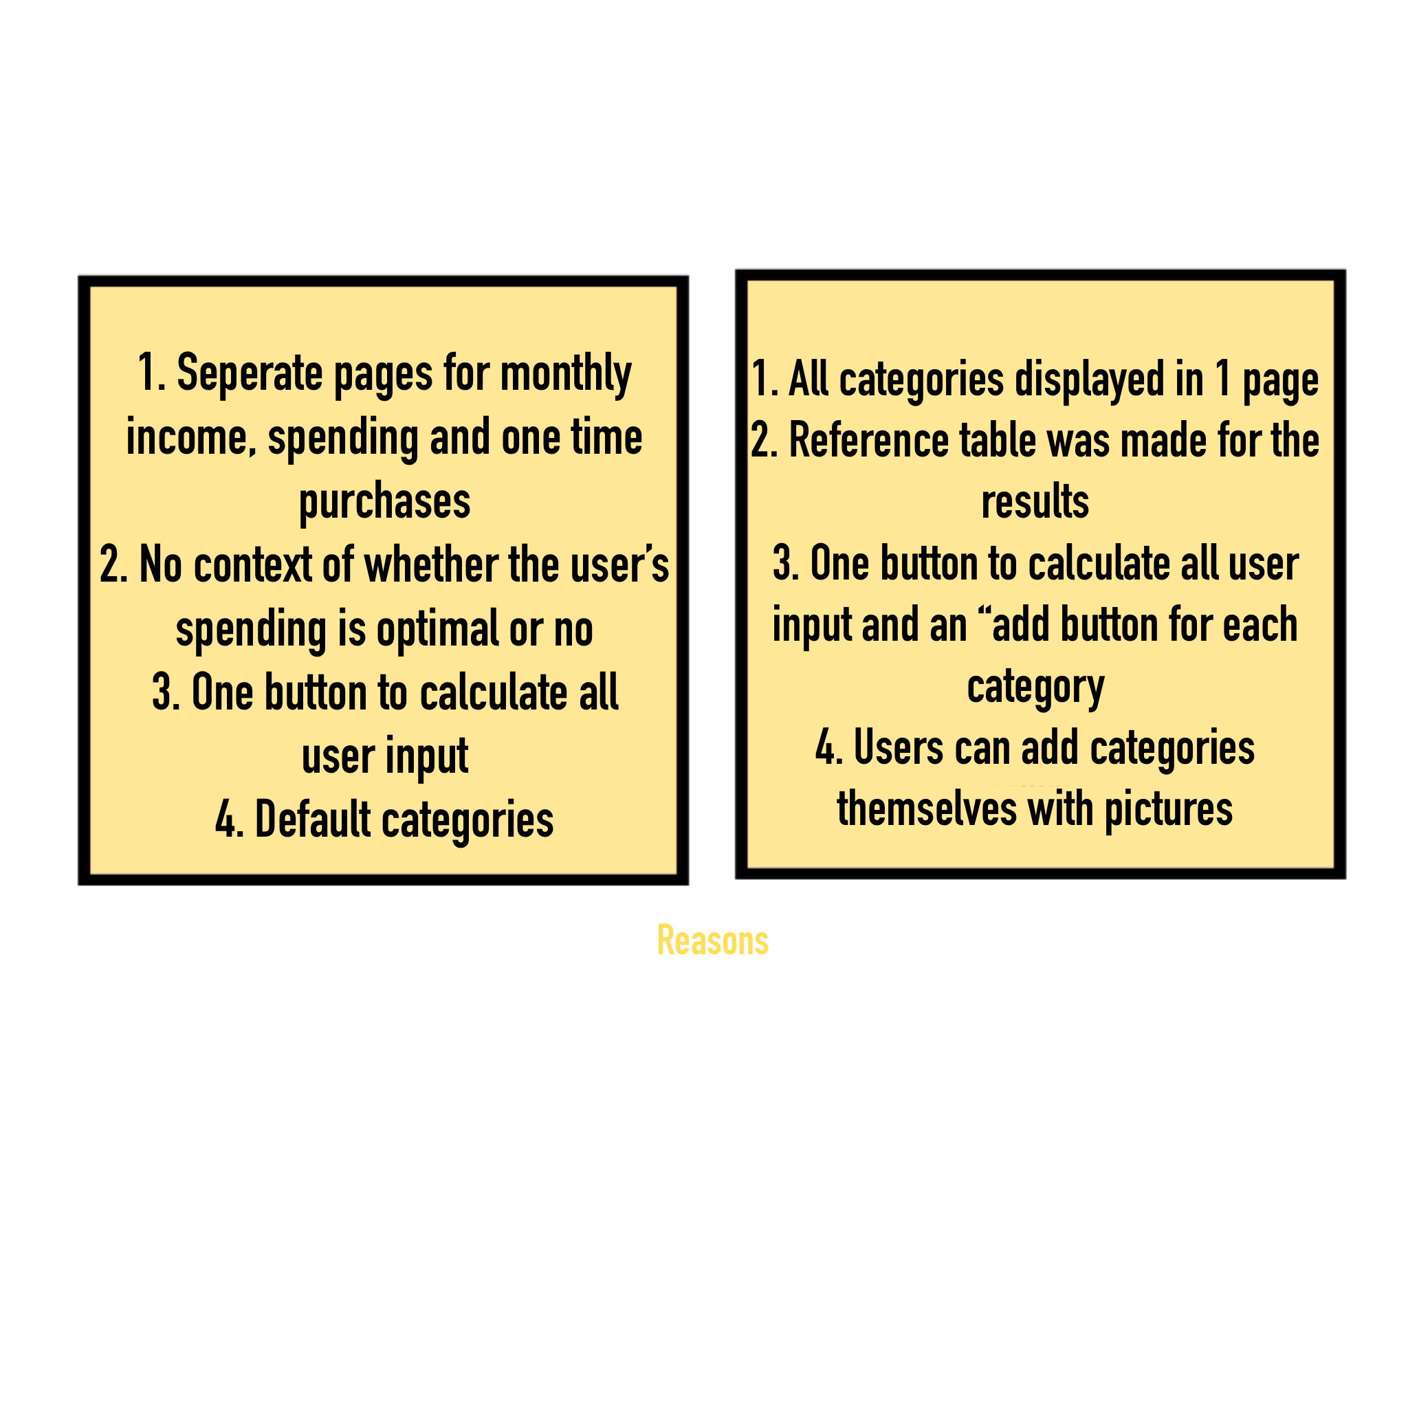
Changes made

Slide 10


